Slide 1
Understanding the NFL
Patrick McNamara
June 6, 2013

Slide 2
Problem
The NFL is America’s most popular sport, generating $10b in revenue in 2012.
Our understanding of the sport pales in comparison to the MLB or even the NBA
Can we predict the winner and total points using basic post-game statistics?

Slide 3
Data & Methodology
NFL play-by-play data from 2002-2012
500k plays, 2900 games, including playoffs
Yardline, play type, game date, etc.
Stadium type, time zone
Overtime games excluded due to errors
Quantitative and Qualitative problems
Linear Regression & KNN with validation
Post-game perspective vs. pre-game perspective

Slide 4
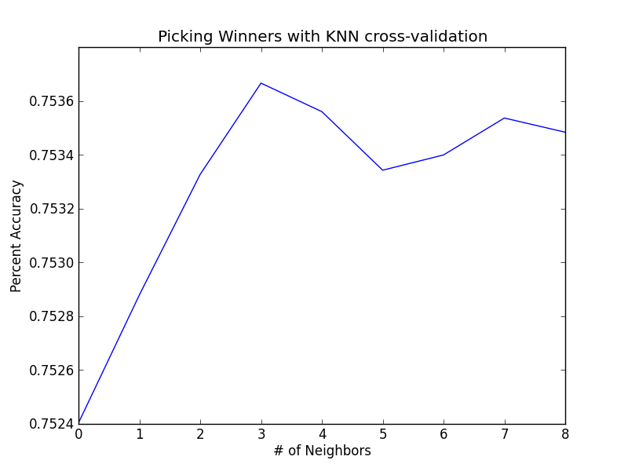
Predicting Winners and Losers
Setup with a 70/30 split
100 simulations
Tested 1 to 10 neighbors
Accuracy steady around
75.3%
Breadth and depth of
data may limit impact of additional neighbors

Slide 5
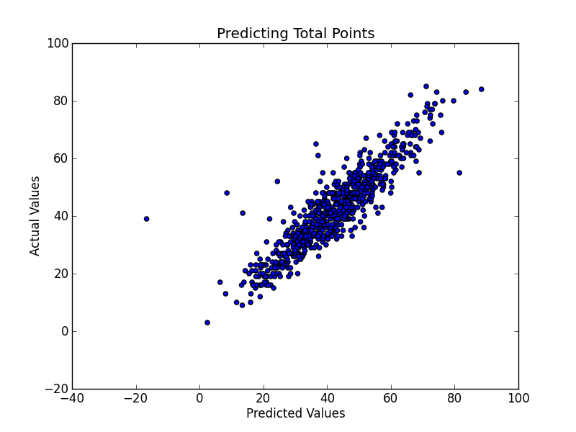
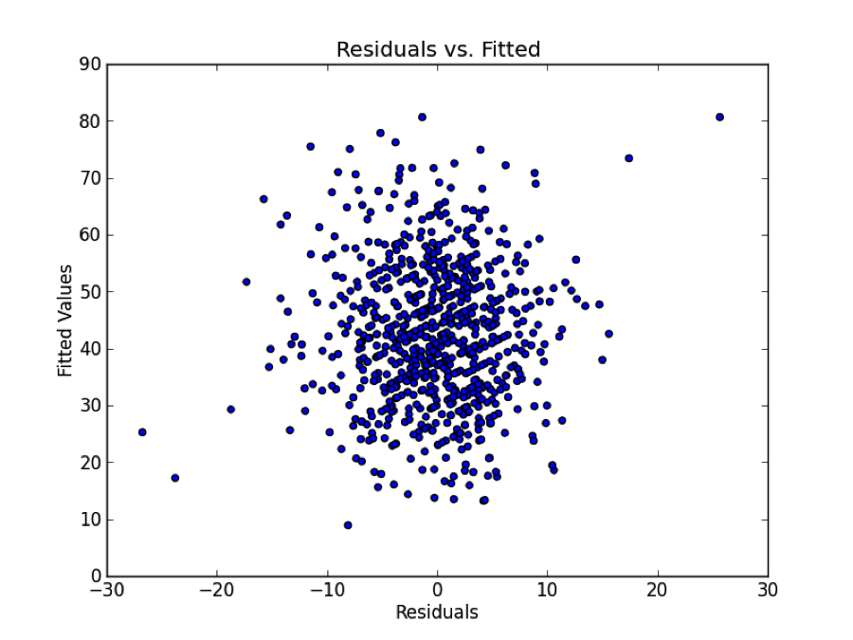
Predicting Total Points
Same 70/30 split
Backwards elimination
100 simulations
Absolute percent error
Accuracy improves slightly
from 19.8% after removal
Playoffs, Month, Season all
less important than theorized
Travel has differing effects
Domes don’t add many points

Slide 6
Conclusions and Future Research
Methods appropriate to the problem
Professional football is a random sport
75% isn’t very accurate when you think about the data we have available
Weather data will almost certainly improve both
Pre-game prediction
Applications for betting markets, commentary, fantasy football

Slide 7
QUESTIONS???

